Slide 1
Brazil IPS premisses
Data currently available on RNDS will be used to generate the first version of Brazil IPS
More than 1.2 billion immunization records of 103 different vaccines ( at least 4 of them do not exist on SNOMED core…)
More than 800.000 Lab reports of COVID-19 and Monkeypox exams
It is expected that till October we will also have allergies and medications from eSUS-AB the Brazilian primary care information system used in 82% of our primary care units

Slide 2
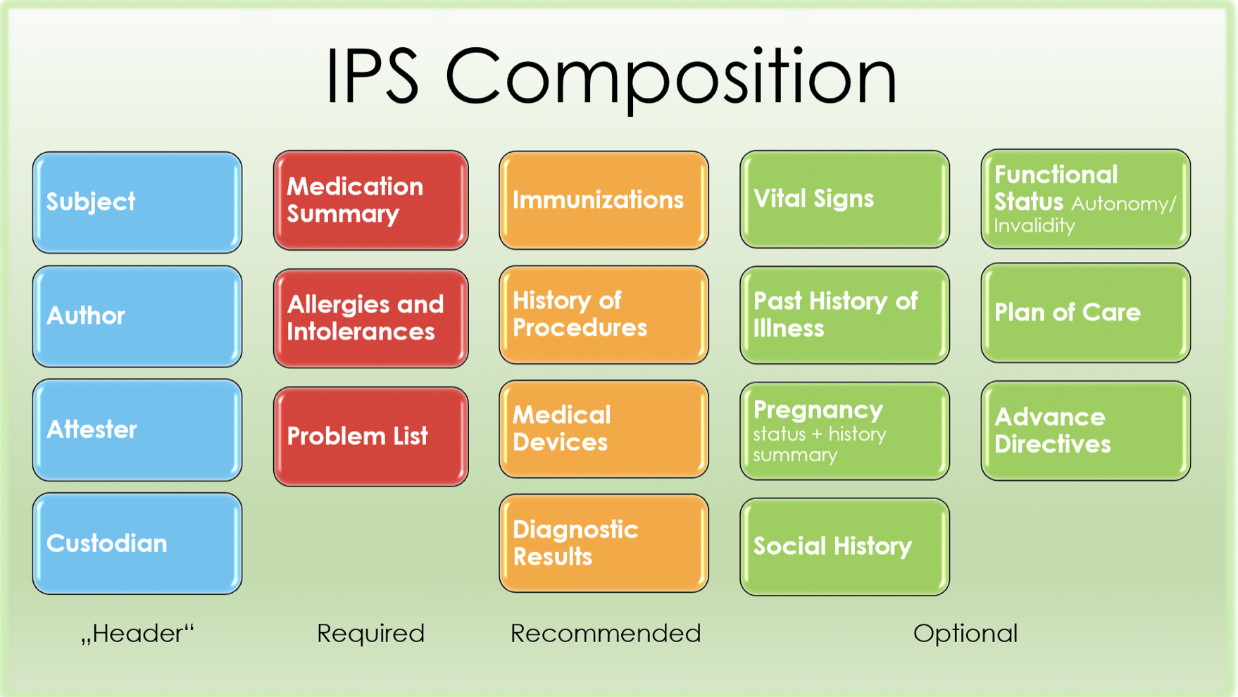
http://hl7.org/fhir/uv/ips/

Slide 3
Current Status IPS-Brasil
80% of the Brazilian RNDS CodeSystems, ValueSets and ConceptMaps of Immunization(IPS), Diagnostic Report(IPS), Allergy Intolerance(IPS), and Medication (IPS) loaded in OCL terminology server;
20% of the FHIR IPS profiles in FHIRSH for those sections that will be in the first version of the Brazilian IPS (Immunization(IPS), Diagnostic Report(IPS), Allergy Intolerance(IPS), and Medication (IPS)

Slide 4
Our proposal
Base resource (R4)
Patient R4
Publish IPS Brasil with HL7 Brazil’s assistance
IPS Brazil will be a use case agnostic/generalist use case that defines a minimal semantic set, and an extensible/permissive set of profiles for national use
Some profiles will derive IPS Brasil for generalist or less restrictive use cases
National generalist/restrictive profiles can extend IPS Brasil with more specific use cases
Regional profiles might include regional based restrictions, like identifiers, and semantic sets.
Use case agnostic national profile
IPS Brazil Paciente
Use case generalist national profile
Use case restrictive national profile
Beneficiary Patient
Use Case Restrictive Regional Profile
SESA-BA Patient
Implementation Profile (Most Restrictive)
International use case
BRIndividuo-1.0 Patient
IPS Patient

